Slide 1
Relational Databases
CS 240 – Advanced Programming Concepts

Slide 2
Relational Databases Overview

Slide 3
Database Management Systems (DBMS)
Databases are implemented by software systems called Database Management Systems (DBMS)
Commonly used Relational DBMS’s include Oracle, MySQL, PostgreSQL, and MS SQL Server
DBMS’s store data in files in a way that scales to large amounts of data and allows data to be accessed efficiently

Slide 4
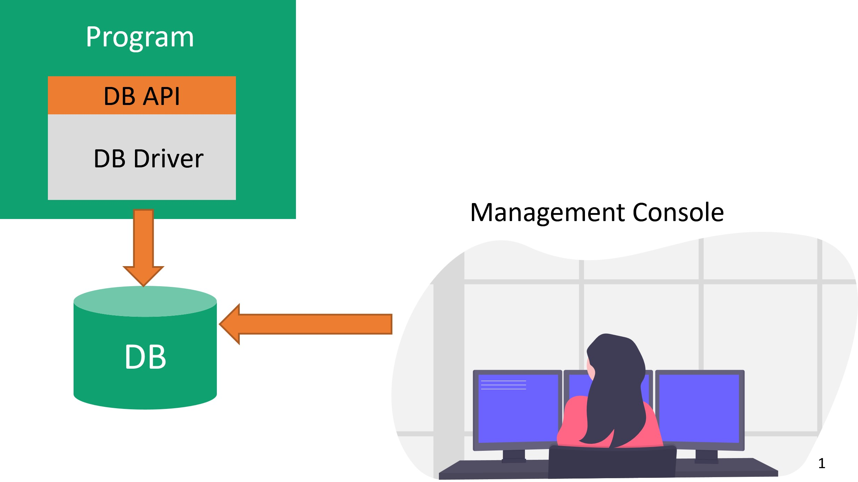
Programmatic vs. Interactive Database Access
Programs can access a database through APIs
such as JDBC or ADO.NET.
End users can access a database through an
interactive management application that allows
them to query and modify the database.

Slide 5
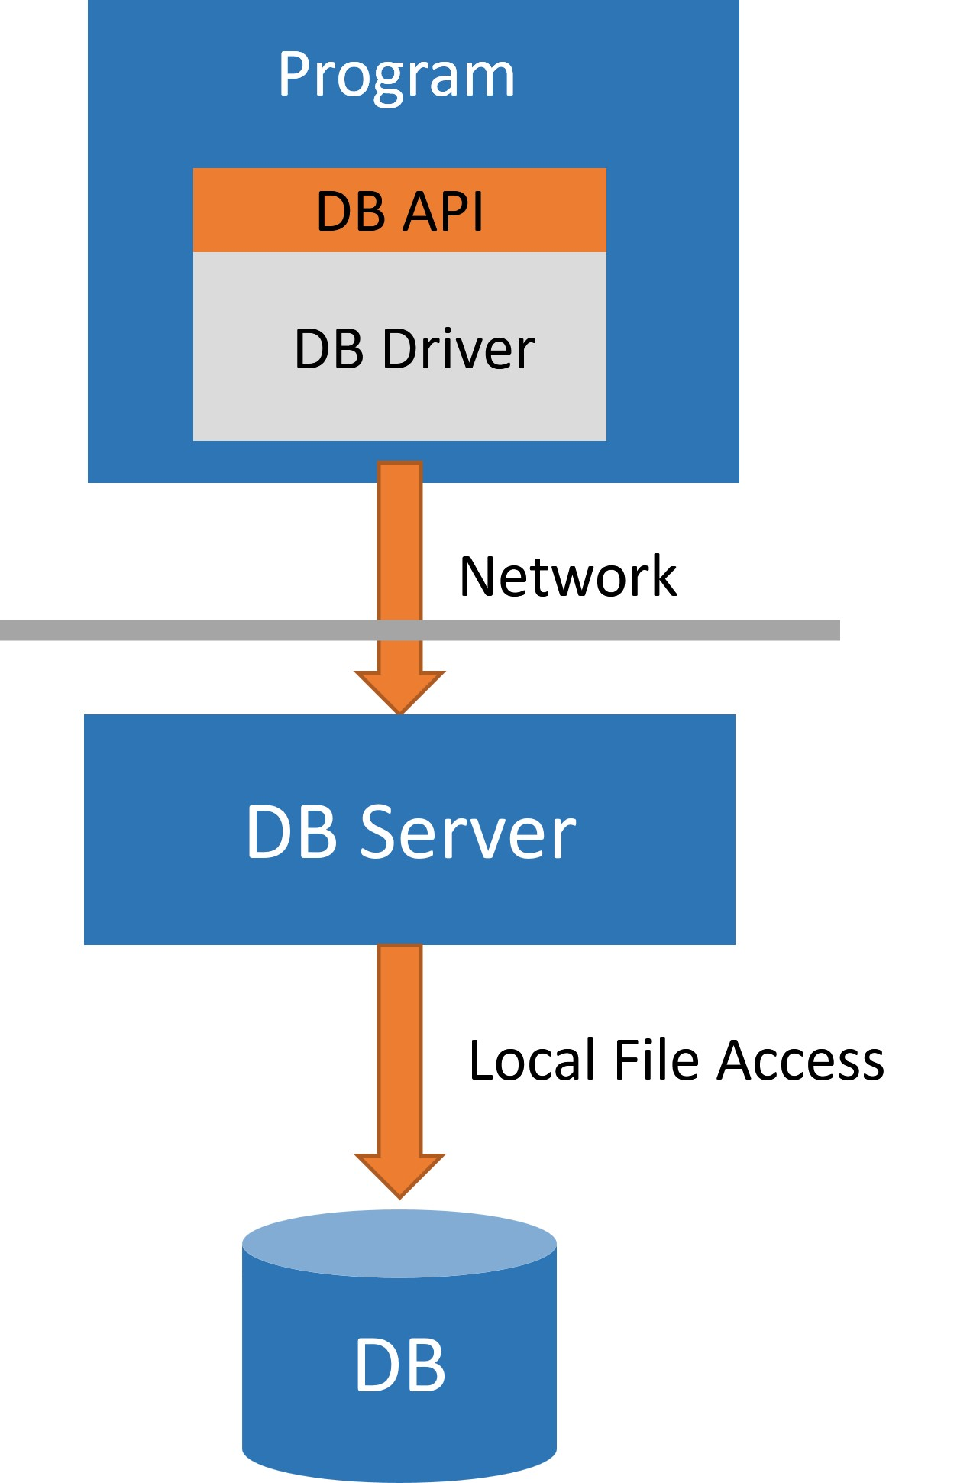
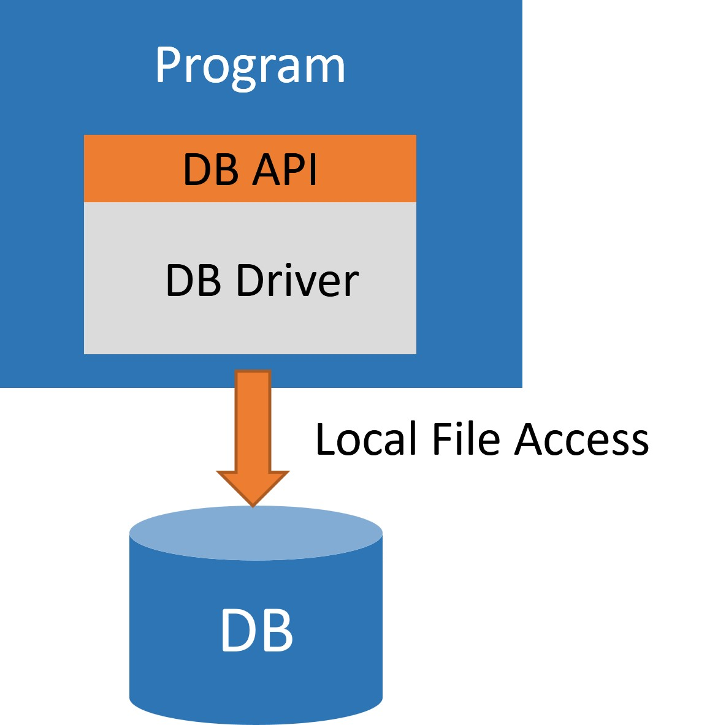
Embedded vs. Client/Server
Some DBMS's are Embedded only
Some are Client/Server only
Some can work in either mode
5

Slide 6
Relational Databases
Relational databases use the relational data model you learned about in CS 236
Relations = Tables
Tuples = Rows
In the relational data model, data is stored in tables consisting of columns and rows.
Tables are like classes
Each row in a table stores the data you may think of as belonging to an object.
Columns in a row store the object’s attributes (instance variables).
Each row has a “Primary Key” which is a unique identifier for that row. Relationships between rows in different tables are represented using keys.
The primary key in one table matches a foreign key in another table
Taken together, all the table definitions in a database make up the “schema” for the database.

Slide 7
Comparison of Object and Relational Models
Object Model | Relational Data Model
Class | Table
Object | Row
Relationship (reference) | Relationship (primary and foreign key)

Slide 8
Citations
Programmer (no link, search Programmer). Undraw (Open License).
Other diagrams created by course authors, Ken Rodham and Jerod Wilkerson.

Slide 9
Understanding the Relational Model
The Book Club Example

Slide 10
Book Club Schema
books_read
member_id | book_id
1 | 1
1 | 2
2 | 2
2 | 3
3 | 3
3 | 4
member
id | name | email_address
1 | ‘Ann’ | ‘ann@cs.byu.edu’
2 | ‘Bob’ | ‘bob@cs.byu.edu’
3 | ‘Chris’ | ‘chris@cs.byu.edu’
book
genre
id | title | author | genre | category_id
1 | ‘Decision Points’ | ‘George W. Bush’ | ‘NonFiction’ | 7
2 | ‘The Work and the Glory’ | ‘Gerald Lund’ | ‘HistoricalFiction’ | 3
3 | ‘Dracula’ | ‘Bram Stoker’ | ‘Fiction’ | 8
4 | ‘The Holy Bible’ | ‘The Lord’ | ‘NonFiction’ | 5
genre | description
‘NonFiction’ | …
‘Fiction’ | …
‘HistoricalFiction’ | …

Slide 11
Book Club Schema (cont.)
category
id | name | parent_id
1 | ‘Top’ | Null
2 | ‘Must Read’ | 1
3 | ‘Must Read (New)’ | 2
4 | ‘Must Read (Old)’ | 2
5 | ‘Must Read (Really Old)’ | 2
6 | ‘Optional’ | 1
7 | ‘Optional (New)’ | 6
8 | ‘Optional (Old)’ | 6
9 | ‘Optional (Really Old)’ | 6

Slide 12
Modeling Object Relationships
Connections between objects are represented using foreign keys
Foreign Key: A column in table T₁ stores primary keys of rows in table T₂
Book Club Examples
Books_Read table stores Member and Book keys
Book table stores Category key
Category table stores parent Category key

Slide 13
Modeling Object Relationships (cont.)
Types of Object Relationships
One-to-One
A Person has one Head; A Head belongs to one Person
Either table contains a foreign key referencing the other table
One-to-Many
A Book has one Category; a Category has many Books
A Book has one Genre; a Genre has many Books
A Category has one parent Category; a Category has many sub Categories
The “Many” table contains a foreign key referencing the “One” table
Many-to-Many
A Member has read many Books; a Book has been read by many Members
Create a “join table” (sometimes called an intersecting entity) whose rows contain foreign keys of both tables

Slide 14
BLANK SLIDE

Slide 15
Modeling a Database Schema
Entity Relationship Diagrams (ERDs) and UML

Slide 16
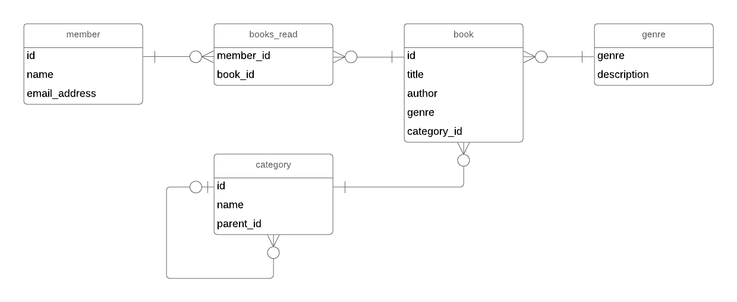
Book Club Entity Relationship Diagram (ERD)

Slide 17

Book Club Database Model (UML)

Slide 18
Citations (Understanding the Relational Model)
Diagrams created by course authors, Ken Rodham and Jerod Wilkerson.

Slide 19
Modeling Inheritance Relationships

Slide 20
Modeling Inheritance Relationships
How do we map the following Class Model to an RDBMS
Owner
Account
name_ : String
owner_
id_ : String
taxId_ : String
1
*
balance_ : double
InterestBearingAccount
CheckingAccount
rate_ : double
checkFee_ double
termDays_ : int
minimumBalance_ : double

Slide 21
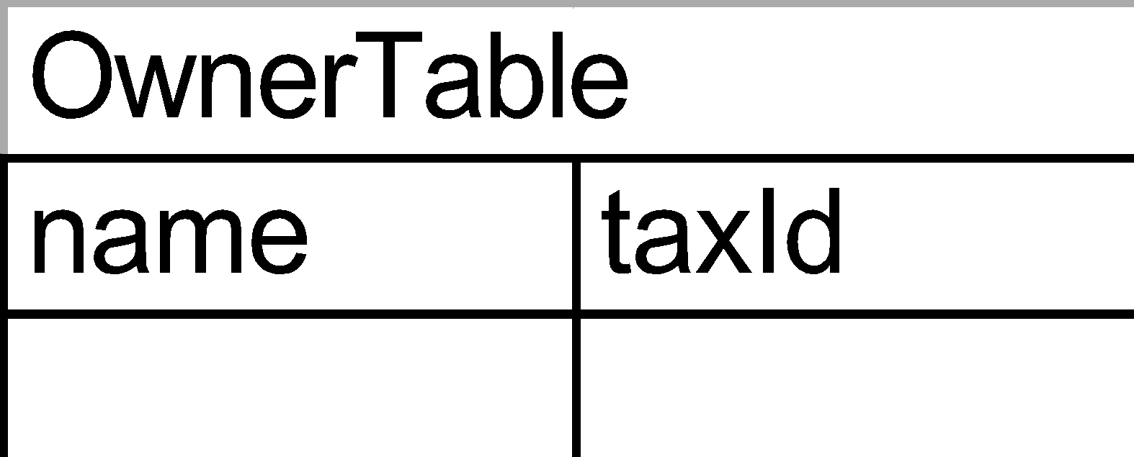


Horizontal Partitioning
Each concrete class is mapped to a table
Owner
Account
name_ : String
owner_
id_ : String
taxId_ : String
1
*
balance_ : double
InterestBearingAccount
CheckingAccount
rate_ : double
checkFee_ double
termDays_ : int
minimumBalance_ : double

Slide 22
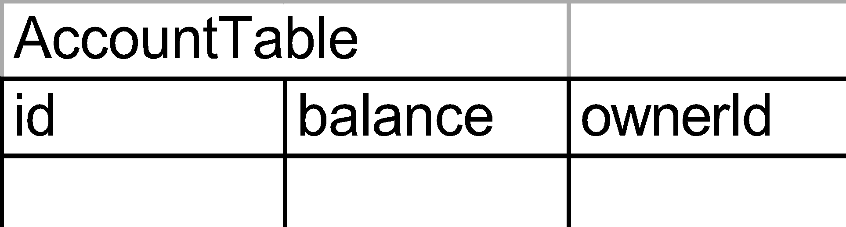
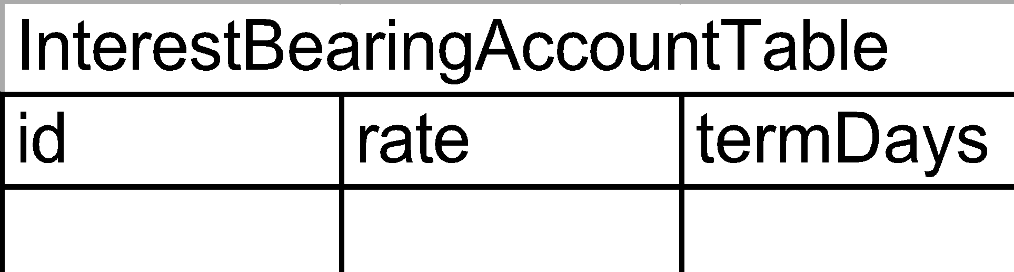

Vertical Partitioning
Each class is mapped to a table
Owner
Account
name_ : String
owner_
id_ : String
taxId_ : String
1
*
balance_ : double
InterestBearingAccount
CheckingAccount
rate_ : double
checkFee_ double
termDays_ : int
minimumBalance_ : double

Slide 23

Unification
Each sub-class is mapped to the same table
Owner
Account
name_ : String
owner_
id_ : String
taxId_ : String
1
*
balance_ : double
InterestBearingAccount
CheckingAccount
rate_ : double
checkFee_ double
termDays_ : int
minimumBalance_ : double

Slide 24
RDBMS Mapping
Horizontal Partitioning
Entire object within one table
Only one table required to activate object
No unnecessary fields in the table
Must search over multiple tables for common properties
Vertical Partitioning
Object spread across different tables
Must join several tables to activate object
Vertical Partitioning (cont.)
No unnecessary fields in each table
Only need to search over parent tables for common properties
Unification
Entire object within one table
Only one table required to activate object
Unnecessary (blank) fields in the table
All sub-types will be located in a search of the common table

Slide 25
Citations (Modeling Inheritance Relationships)
Diagrams created by course authors, Ken Rodham and Jerod Wilkerson.

Slide 26
Structured Query Language (SQL)

Slide 27
SQL
Language for performing relational database operations
Create tables
Delete tables
Insert rows
Update rows
Delete rows
Query for matching rows
Much more …

Slide 28
BLANK SLIDE

Slide 29
SQL Data Types

Slide 30
SQL Data Types – Strings
Each column in an SQL table declares the type that column may contain
Character strings
CHARACTER(n) or CHAR(n) — fixed-width n-character string, padded with spaces as needed
CHARACTER VARYING(n) or VARCHAR(n) — variable-width string with a maximum size of n characters
Bit strings
BIT(n) — an array of n bits
BIT VARYING(n) — an array of up to n bits

Slide 31
SQL Data Types – Numbers and Large Objects
Numbers
INTEGER and SMALLINT
FLOAT, REAL and DOUBLE PRECISION
NUMERIC(precision, scale) or DECIMAL(precision, scale)
Large objects
BLOB – binary large object (images, sound, video, etc.)
CLOB – character large object (text documents)

Slide 32
SQL Data Types – Date and Time
DATE — for date values (e.g., 2011-05-03)
TIME — for time values (e.g., 15:51:36). The granularity of the time value is usually a tick (100 nanoseconds).
TIME WITH TIME ZONE or TIMETZ — the same as TIME, but including details about the time zone.
TIMESTAMP — This is a DATE and a TIME put together in one variable (e.g., 2011-05-03 15:51:36).
TIMESTAMP WITH TIME ZONE or TIMESTAMPTZ — the same as TIMESTAMP, but including details about the time zone.

Slide 33
SQLite Data Types
SQLite is a lightweight (simple) RDBMS we will use in this class
SQLite stores all data using the following data types
INTEGER
REAL
TEXT
BLOB
SQLite supports the standard SQL data types by mapping them onto the INTEGER, REAL, TEXT, and BLOB types

Slide 34
BLANK SLIDE

Slide 35
Creating and Dropping Tables

Slide 36
Creating Tables
CREATE TABLE
Primary Keys
Null / Not Null
Autoincrement
Foreign keys
create table book
(
id integer not null primary key autoincrement,
title varchar(255) not null,
author varchar(255) not null,
genre varchar(32) not null,
category_id integer not null,
foreign key(genre) references genre(genre),
foreign key(category_id) references category(id)
);

Slide 37
Foreign Key Constraints
Not required – can query without them
Enforce that values used as foreign keys exist in their parent tables
Disallow deletes of the parent table row when referenced as a foreign key in another table
Disallow updates of the parent row primary key value if that would “orphan” the foreign keys
Can specify that deletes and/or updates to the primary keys automatically affect the foreign key rows
foreign key(genre) references genre(genre) on update cascade on delete restrict
Available actions:
No Action, Restrict, Set Null, Set Default, Cascade

Slide 38
Dropping Tables
Drop Table
drop table book;
drop table if exists book;
When using foreign key constraints, order of deletes matters
Can’t delete a table with values being used as foreign keys in another table (delete the table with the foreign keys first)

Slide 39
BLANK SLIDE

Slide 40
Inserting, Updating and Deleting Rows

Slide 41
Inserting Data into Tables
INSERT
insert into book
(title, author, genre, category_id) values ('The Work and the Glory', 'Gerald Lund', 'HistoricalFiction', 3);
________________
Complete Example
create-db.sql.txt

Slide 42
Updates
UPDATE Table
SET Column = Value, Column = Value, …
WHERE Condition
Change a member’s information
UPDATE member
SET name = ‘Chris Jones’,
email_address = ‘chris@gmail.com’
WHERE id = 3
Set all member email addresses to empty
UPDATE member
SET email_address = ‘’

Slide 43
Deletes
DELETE FROM Table
WHERE Condition
Delete a member
DELETE FROM member
WHERE id = 3
Delete all readings for a member
DELETE FROM books_read
WHERE member_id = 3
Delete all books
DELETE FROM book

Slide 44
BLANK SLIDE

Slide 45
Retrieving Data with SQL Queries

Slide 46
Queries
SELECT Column, Column, …
FROM Table, Table, …
WHERE Condition

Slide 47
Queries (2)
book
id | title | author | genre | category_id
1 | ‘Decision Points’ | ‘George W. Bush’ | ‘NonFiction’ | 7
2 | ‘The Work and the Glory’ | ‘Gerald Lund’ | ‘HistoricalFiction’ | 3
3 | ‘Dracula’ | ‘Bram Stoker’ | ‘Fiction’ | 8
4 | ‘The Holy Bible’ | ‘The Lord’ | ‘NonFiction’ | 5
List all books
SELECT *
FROM book
result
id | title | author | genre | category_id
1 | ‘Decision Points’ | ‘George W. Bush’ | ‘NonFiction’ | 7
2 | ‘The Work and the Glory’ | ‘Gerald Lund’ | ‘HistoricalFiction’ | 3
3 | ‘Dracula’ | ‘Bram Stoker’ | ‘Fiction’ | 8
4 | ‘The Holy Bible’ | ‘The Lord’ | ‘NonFiction’ | 5

Slide 48
Queries (3)
book
id | title | author | genre | category_id
1 | ‘Decision Points’ | ‘George W. Bush’ | ‘NonFiction’ | 7
2 | ‘The Work and the Glory’ | ‘Gerald Lund’ | ‘HistoricalFiction’ | 3
3 | ‘Dracula’ | ‘Bram Stoker’ | ‘Fiction’ | 8
4 | ‘The Holy Bible’ | ‘The Lord’ | ‘NonFiction’ | 5
List the authors and titles of all non-fiction books
SELECT author, title
FROM book
WHERE genre = ‘NonFiction’
result
author | title
‘George W. Bush’ | ‘Decision Points’
‘The Lord’ | ‘The Holy Bible’

Slide 49
Queries (4)
category
id | name | parent_id
1 | ‘Top’ | Null
2 | ‘Must Read’ | 1
3 | ‘Must Read (New)’ | 2
4 | ‘Must Read (Old)’ | 2
5 | ‘Must Read (Really Old)’ | 2
6 | ‘Optional’ | 1
7 | ‘Optional (New)’ | 6
8 | ‘Optional (Old)’ | 6
9 | ‘Optional (Really Old)’ | 6
List the sub-categories of category ‘Top’
SELECT id, name, parent_id
FROM category
WHERE parent_id = 1
result
id | name | parent_id
2 | ‘Must Read’ | 1
6 | ‘Optional’ | 1

Slide 50
Queries – Cartesian Product
List the books read by each member
SELECT member.name, book.title
FROM member, books_read, book
Member x Books_Read x Book (3 x 6 x 4 = 72 rows)
name | title
‘Ann’ | ‘Decision Points’
‘Ann’ | ‘The Work and the Glory’
‘Ann’ | ‘Dracula’
‘Ann’ | ‘The Holy Bible’
‘Ann’ | ‘Decision Points’
… | …
‘Chris’ | ‘The Holy Bible’
Probably not what you intended

Slide 51
Queries - Join
List the books read by each member
SELECT member.name, book.title
FROM member, books_read, book
WHERE member.id = books_read.member_id AND
book.id = books_read.book_id
result
name | title
‘Ann’ | ‘Decision Points’
‘Ann’ | ‘The Work and the Glory’
‘Bob’ | ‘The Work and the Glory’
‘Bob’ | ‘Dracula’
‘Chris’ | ‘Dracula’
‘Chris’ | ‘The Holy Bible’

Slide 52
Queries – Join 2
List the non-fiction books read by each member
SELECT member.name, book.title
FROM member, books_read, book
WHERE member.id = books_read.member_id AND
book.id = books_read.book_id AND
genre = "NonFiction"
result
name | title
‘Ann’ | ‘Decision Points’
‘Chris’ | ‘The Holy Bible’

Slide 53
Queries – Join 2 (with Join Clauses)
List the non-fiction books read by each member
SELECT member.name, book.title
FROM member
INNER JOIN books_read ON member.id = books_read.member_id
INNER JOIN book ON books_read.book_id = book.id
WHERE genre = "NonFiction"
result
name | title
‘Ann’ | ‘Decision Points’
‘Chris’ | ‘The Holy Bible’

Slide 54
BLANK SLIDE

Slide 55
Database Transactions

Slide 56
Database Transactions
By default, each SQL statement is executed in a transaction by itself
Transactions are useful when they consist of multiple SQL statements, since you want to make sure that either all of them or none of them succeed
For a multi-statement transaction,
BEGIN TRANSACTION;
SQL statement 1;
SQL statement 2;
…
COMMIT TRANSACTION; or ROLLBACK TRANSACTION;

Slide 57
Blank

Slide 58
Java Database Access with JDBC
Executing SQL from Java

Slide 59
Database Access from Java
Load database driver
Open a database connection
Start a transaction
Execute queries and/or updates
Commit or Rollback the transaction
Close the database connection
Retrieving auto-increment ids
Omit transaction steps if you only need to execute a single statement.

Slide 60
Load Database Driver
try {
// Legacy. Modern DB drivers don’t require this
Class.forName("org.sqlite.JDBC");
} catch(ClassNotFoundException e) {
// ERROR! Could not load database driver
}

Slide 61
Open a Database Connection / Start a Transaction
import java.sql.*;
...
String dbName = "db" + File.separator + "bookclub.sqlite";
String connectionURL = "jdbc:sqlite:" + dbName;
Connection connection = null;
try(Connection c = DriverManager.getConnection(connectionURL)) {
connection = c;
// Start a transaction
connection.setAutoCommit(false);
} catch(SQLException ex) {
// ERROR
}
Close the connection when you are through with it. Or open it in a try-with-resources statement.
Don’t close before you commit or rollback your transaction.

Slide 62
Execute a Query
List<Book> books = new ArrayList<>();
String sql =
"select id, title, author, genre, category_id from book";
try(PreparedStatement stmt = connection.prepareStatement(sql);
ResultSet rs = stmt.executeQuery()) {
while(rs.next()) {
int id = rs.getInt(1);
String title = rs.getString(2);
String author = rs.getString(3);
String genre = rs.getString(4);
int categoryId = rs.getInt(5);
books.add(new Book(id, title, author, genre, categoryId));
}
} catch (SQLException ex) {
// ERROR
}

Slide 63
Execute an Insert, Update, or Delete
String sql = "update book " +
"set title = ?, author = ?, genre = ?, category_id = ? " +
"where id = ?";
try(PreparedStatement stmt = connection.prepareStatement(sql)) {
stmt.setString(1, book.getTitle());
stmt.setString(2, book.getAuthor());
stmt.setString(3, book.getGenre());
stmt.setInt(4, book.getCategoryId());
stmt.setInt(5, book.getId());
if(stmt.executeUpdate() == 1) {
System.out.println("Updated book " + book.getId());
} else {
System.out.println(
"Failed to update book " + book.getId());
}
} catch(SQLException ex) {
// ERROR
}
Assumes we have a reference named ‘book’ to an object that contains the values we need.

Slide 64

Prevent SQL Injection Attacks with Parameter Replacement in PreparedStatements
1

Slide 65
Commit or Rollback a Transaction
Connection connection = null;
try(Connection c = DriverManager.getConnection(connectionURL)) {
connection = c;
...
connection.commit();
} catch(SQLException ex) {
if(connection != null) {
connection.rollback();
}
throw ex;
}
Close the connection when you are through with it, or open it in a try-with-resources statement.

Slide 66
Retrieving Auto-increment IDs (from SQLite)
String sql = "insert into book (title, author, genre, category_id) values (?, ?, ?, ?)";
try(PreparedStatement stmt = connection.prepareStatement(sql)) {
for(Book book : books) {
stmt.setString(1, book.getTitle());
stmt.setString(2, book.getAuthor());
stmt.setString(3, book.getGenre());
stmt.setInt(4, book.getCategoryId());
if(stmt.executeUpdate() == 1) {
try(Statement keyStmt = connection.createStatement();
ResultSet keyRS = keyStmt.executeQuery(
"select last_insert_rowid()")) {
keyRS.next();
int id = keyRS.getInt(1); // ID of the inserted book
book.setId(id);
}
} else {
// ERROR
}
}
} catch (SQLException ex) {
// ERROR
}

Slide 67
Citations (Java Database Access with JDBC)
1. Randall Munroe. Exploits of a Mom. xkcd. (Open License)

Slide 68
JDBC: Putting it All Together

Slide 69
Putting It All Together
Code Example
DatabaseAccessExample.java
Book.java

Slide 70
BLANK SLIDE

Slide 71
The SQLite RDMS

Slide 72
SQLite
A lightweight (simple to use) RDBMS
Open-Source
Simple to use and setup (compared to other RDBMSs)
No need to install SQLite to use it
Create, browse and manually manipulate a SQLite database from a GUI browser (which you will need to install)

Slide 73
Installing a GUI Browser/Admin Tool
Stand-Alone Tool (recommended)
Download and install DB Browser for SQLite
Browser Extensions
There are extensions for the popular browsers (find them with a Google search)

Slide 74
BLANK SLIDE

Slide 75
Accessing SQLite (or any other dependency) from Java
Making the JDBC Driver Available to your Java Project

Slide 76
Accessing SQLite from Java: Using Intellij’s Built-In Dependency Management
Find the jar you want in the Maven Repository
Add it as a dependency in Intellij to any Java project (doesn’t have to be a Maven project)
Doesn’t provide the full functionality of a Maven project but you don’t need that for this class
Avoids issues with the integration between Maven and Intellij
THIS IS THE RECOMMENDED WAY FOR THIS CLASS

Slide 77
Accessing SQLite from Java: Manual Library Install
Use this method if you are not using a dependency manager such as Gradle or Maven
Download the latest JDBC driver
https://bitbucket.org/xerial/sqlite-jdbc/downloads/
All IDEs
Create a folder called ‘lib’ in your project folder.
Copy the JDBC driver .jar file into the ‘lib’ folder.
Intellij
Go to File -> Project Structure
Project Settings -> Libraries -> “+” sign -> Java
Select the .jar file from the ‘lib’ directory
Press OK until you are back at the main window
Android Studio (preferred method is to use Gradle)
Go to File -> Project Structure
Modules -> Your Module (probably named app) -> Dependencies -> “+” sign -> Jar Dependency
Select the .jar file from the ‘lib’ directory
Press OK until you are back at the main window
Eclipse
Refresh your project in eclipse.
Select the .jar file from the ‘lib’ directory, right click and select Build Path -> Add to Build Path

Slide 78
Accessing SQLite from Java: Using a Dependency Manager
Use a dependency manager (Maven or Gradle)
Android Studio projects use Gradle
Will learn more in CS 203

Slide 79
BLANK SLIDE

